Slide 1

INSIDE THE WINDOWS OPERATING SYSTEM
IS3313
Materials in this presentation are based primarily, but not exclusively, on Chapter 1 of Windows Internals by Mark E. Russinovich, David A. Solomon, Alex Ionescu. © Microsoft Press.

Slide 2


RAM
L2 Cache
L1 D Cache
Register Set 1
Branch Unit
Register Set 2
Branch Unit
Instruction Pre-decode &Queue
Retirement Unit
L1 I Cache
Decode Units
Buffer
Instruction Pre-decode &Queue
Reservation Station
Reorder Buffer/ Instruction Pool
Hyperthreading Technology
ILP and TLP
Execution Units
Buffer
Notes:
L1 and L2: https://www.extremetech.com/extreme/188776-how-l1-and-l2-cpu-caches-work-and-why-theyre-an-essential-part-of-modern-chips

Slide 3
Windows Versions
Product Name | Internal Version Number | Release Date
Windows NT 3.1 | 3.1 | July 1993
Windows NT 3.5 | 3.5 | September 1994
Windows NT 3.51 | 3.51 | May 1995
Windows NT 4.0 | 4.0 | July 1996
Windows 2000 | 5.0 | December 1999
Windows XP | 5.1 | August 2001
Windows Server 2003 | 5.2 | March 2003
Windows Vista | 6.0 | January 2007
Windows Server 2008 | 6.0 | March 2008
Windows 8 | 6.2 | October 2012
Windows Server 2012 | 6.2 | October 2012

Slide 4
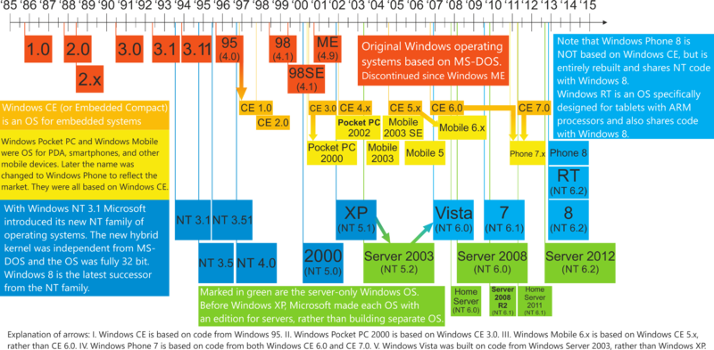
Windows Family Tree

Slide 5
Windows OS
From the start, Microsoft made the following architectural commitments:
Compatibility
Reliability
Security
Portability
Modularity
Performance

Slide 6
System Architecture
System Processes
Services
Applications
Environment
Subsystems
Service
Control Mgr.
SvcHost.Exe
POSIX
LSASS
Task Manager
WinMgt.Exe
Explorer
WinLogon
SpoolSv.Exe
OS/2
User
Application
User
Mode
Session Manager
Services.Exe
Windows
Subsystem DLLs
System
Threads
NTDLL.DLL
Kernel
Mode
System Service Dispatcher
(kernel mode callable interfaces)
Windows
USER,
GDI
I/O Mgr
File
System
Cache
Object
Mgr.
Plug and
Play Mgr.
Power
Mgr.
Security
Reference
Monitor
Virtual
Memory
Processes
&
Threads
Configura-
tion Mgr
(registry)
Local
Procedure
Call
Device &
File Sys.
Drivers
Graphics
Drivers
Kernel
Hardware Abstraction Layer (HAL)
hardware interfaces (buses, I/O devices, interrupts,
interval timers, DMA, memory cache control, etc., etc.)
Notes:
©2005 Microsoft Corporation. All rights reserved.
This presentation is for informational purposes only. Microsoft makes no warranties, express or implied, in this summary.

Slide 7
Foundation Concepts and Terms
Windows API
Services, Functions, and Routines
Processes, Threads, and Jobs
Virtual Memory
Kernel Mode vs. User Mode
Terminal Services and Multiple Sessions
Objects
Security
Registry
Unicode

Slide 8
Windows API
The Windows Application Programming Interface (API) is the system programming interface to the Microsoft Windows operating system family.
The programming interface to the 32-bit version of the Windows operating systems was called the Win32 API, to distinguish it from the original 16-bit Windows API, which was the programming interface to the original 16-bit versions of Windows.

Slide 9
Windows API Categories
The Windows API consists of thousands of callable functions, which are divided into the following major categories:
  Base Services
  Component Services
  User Interface Services
  Graphics and Multimedia Services
  Messaging and Collaboration
  Networking
  Web Services

Slide 10
Services, Functions, and Routines
Windows API functions
  Documented, callable subroutines in the Windows API.
  Examples include CreateProcess, CreateFile, and GetMessage.
Native system services (or executive system services)
  The undocumented, underlying services in the operating system that are callable from user mode.
  For example, NtWriteFile.

Slide 11
Services, Functions, and Routines (Cont.)
Kernel support functions (or routines)
  Subroutines inside the Windows operating system that can be called only from kernel mode.
  For example, ExAllocatePool.
Windows services
  Processes started by the Windows service control manager.
  For example, the Task Scheduler service runs in a user-mode process
DLL (dynamic-link library)
  A set of callable subroutines linked together as a binary file that can be dynamically loaded by applications that use the subroutines.
  Examples include Msvcrt.dll and Kernel32.dll.

Slide 12
A Term in Different Contexts Has Different Meanings
Several terms in the Windows user and programming documentation have different meanings in different contexts.
For example, the word service can refer to
  a callable routine in the operating system
  a device driver
  or
  a server process.

Slide 13
Windows API Functions
Documented, callable subroutines in the Windows API.
  Examples include
    CreateProcess
    CreateFile
    and
    GetMessage.

Slide 14
Native System Services (or Executive System Services)
The undocumented, underlying services in the operating system that are callable from user mode.
  For example, NtCreateProcess is the internal system service the Windows CreateProcess function calls to create a new process.

Slide 15
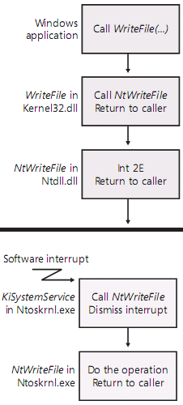
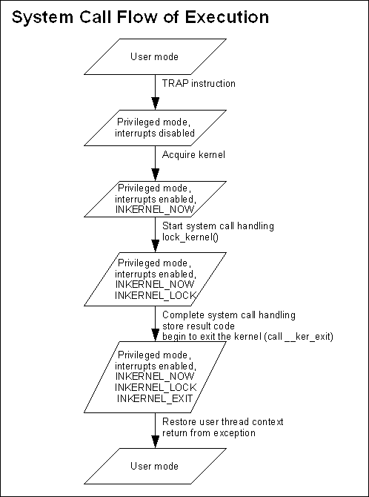
Putting it all together

Slide 16
Kernel Support Functions (or Routines)
Subroutines inside the Windows operating system that can be called only from kernel mode.
  For example, ExAllocatePool is the routine that device drivers call to allocate memory from the Windows system heaps.

Slide 17
Windows Services
Processes started by the Windows service control manager.
  Although the registry defines Windows device drivers as "services," we don't refer to them as such in this book.
  For example, the Task Scheduler service runs in a user mode process that supports the at command (which is similar to the UNIX commands at or cron).
    At command, as the name indicates, can be used to schedule applications at specified time and date.
    At 11:00:00PM shutdown -r

Slide 18
DLL (Dynamic-Link Library)
A set of callable subroutines linked together as a binary file that can be dynamically loaded by applications that use the subroutines.
  Examples include Msvcrt.dll (the C run-time library) and Kernel32.dll (one of the Windows API subsystem libraries).
  Windows user-mode components and applications use DLLs extensively.
  The advantage DLLs provide over static libraries is that applications can share DLLs
  Windows ensures that there is only one in-memory copy of a DLL's code among the applications that are referencing it.

Slide 19
Program vs. Process
Although programs and processes appear similar on the surface, they are fundamentally different.
A program is a static sequence of instructions.
A process is a container for a set of resources used when executing the instance of the program.

Slide 20
Components of a Windows Process (1)
A private virtual address space,
  which is a set of virtual memory addresses that the process can use
An executable program,
  which
    defines initial code and data
    and
    is mapped into the process’s virtual address space

Slide 21
Components of a Windows Process (2)
A list of open handles to various system resources, such as
  semaphores
  communication ports
  and
  files,
that are accessible to all threads in the process
Notes:
Semaphores Vs Locks: https://www.youtube.com/watch?v=KZU4ANBoLTY

Slide 22
Components of a Windows Process (3)
A security context called an access token that identifies
  the user
  security groups
  privileges
  User Access Control (UAC) virtualization state
  session
  and
  limited user account state associated with the process

Slide 23
Components of a Windows Process (4)
A unique identifier called a process ID (internally part of an identifier called a client ID)
At least one thread of execution
  (although an “empty” process is possible, it is not useful)
System call
  Primary argument to CreateProcess is image file name (or command line)

Slide 24
Information about the Parent Process
Each process also points to its parent or creator process.
However, if the parent exits, this information is NOT updated.
Therefore, it is possible for a process to point to a nonexistent parent. This is not a problem, as nothing relies on this information being present.

Slide 25
Processes and Threads
Every process starts with one thread
  First thread executes the program’s “main” function
    Can create other threads in the same process
    Can create additional processes
Why divide an application into multiple threads?
  Perceived user responsiveness, parallel/background execution
    Examples: Word background print – can continue to edit during print
  Take advantage of multiple processors
    On an MP system with n CPUs, n threads can literally run at the
    same time
    Question: Given a single threaded application, will adding a second processor make it run faster?
  Does add complexity
    Synchronization
    Scalability well is a different question…
      Number of multiple runnable threads versus number CPUs
      Having too many runnable threads causes excess context switching
Notes:
©2005 Microsoft Corporation. All rights reserved.
This presentation is for informational purposes only. Microsoft makes no warranties, express or implied, in this summary.

Slide 26
Thread
A thread is the entity within a process that Windows schedules for execution.
Without it, the process’s program can’t run.

Slide 27
What is a thread?
An execution context within a process
Unit of scheduling (threads run, processes don’t run)
All threads in a process share the same
per-process address space
  Services provided so that threads can synchronize access to shared resources (critical sections, mutexes, events, semaphores)
All threads in the system are scheduled as peers to all others, without regard to their “parent” process
System call:
  Primary argument to CreateThread is a function entry point address

Slide 28
Components of a Thread (1)
The contents of a set of CPU registers representing the state of the processor.
Two stacks,
  one for the thread to use while executing in kernel mode
  and
  one for executing in user mode.

Slide 29
Components of a Thread (2)
A private storage area called thread-local storage (TLS) for use by
  subsystems
  run-time libraries
  and
  DLLs.

Slide 30
Components of a Thread (3)
A unique identifier called a thread ID (also internally called a client ID).
  Process IDs and thread IDs are generated out of the same namespace, so they never overlap.
Threads sometimes have their own security context that is often used by multithreaded server applications that impersonate the security context of the clients that they serve.

Slide 31
Thread’s Context
The volatile registers, stacks, and private storage area are called the thread’s context.
Because this information is different for each machine architecture that Windows runs on, this structure, by necessity, is architecture-specific.
The Windows GetThreadContext function provides access to this architecture-specific information (called the CONTEXT block).

Slide 32
Fibers vs. Threads
Fibers allow an application to schedule its own “threads” of execution rather than rely on the priority-based scheduling mechanism built into Windows.
Fibers are often called “lightweight” threads.
In terms of scheduling, they’re invisible to the kernel because they’re implemented in user mode in Kernel32.dll.

Slide 33
Execution of Fibers
To use fibers, a call is first made to the Windows ConvertThreadToFiber function.
  This function converts the thread to a running fiber.
Afterward, the newly converted fiber can create additional fibers with the CreateFiber function.
  Each fiber can have its own set of fibers.
Unlike a thread, however, a fiber doesn’t begin execution until it’s manually selected through a call to the SwitchToFiber function.
The new fiber runs until it exits or until it calls SwitchToFiber, again selecting another fiber to run.

Slide 34
Threads within a Process Share the Process’s Virtual Address Space
Although threads have their own execution context, every thread within a process shares the process’s virtual address space (in addition to the rest of the resources belonging to the process).
  i.e., all the threads in a process can write to and read from each other’s memory.

Slide 35
Reference the Address Space of Another Process
Threads cannot accidentally reference the address space of another process, however,
  unless the other process makes available part of its private address space as a shared memory section (called a file mapping object in the Windows API)
  or
  unless one process has the right to open another process to use cross-process memory functions such as ReadProcessMemory and WriteProcessMemory.

Slide 36
Resources of a Process
In addition to a private address space and one or more threads, each process has
  a security identification
  and
  a list of open handles to objects such as
    files
    shared memory sections
    or
    one of the synchronization objects such as
      mutexes
      events
      or
      semaphores.

Slide 37
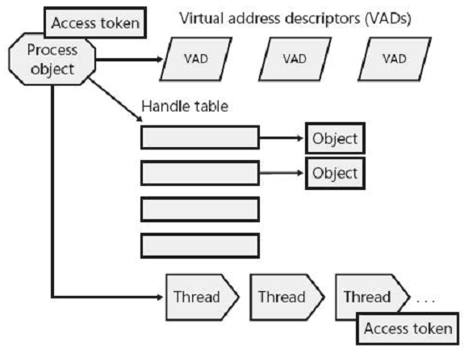
A Process and Its Resources

Slide 38
The Access Token of a Process
Every process has a security context that is stored in an object called an access token.
The process access token contains
  the security identification
  and
  credentials
for the process.

Slide 39
The Access Token of a Thread
By default, threads don’t have their own access token.
But threads can obtain one, thus allowing individual threads to impersonate the security context of another process—including processes running on a remote Windows system—without affecting other threads in the process.

Slide 40
Virtual Address Descriptors
The virtual address descriptors (VADs) are data structures that the memory manager uses to keep track of the virtual addresses the process is using.

Slide 41
Job
Windows provides an extension to the process model called a job.
A job object’s main function is to allow groups of processes to be managed and manipulated as a unit.
In some ways, the job object compensates for the lack of a structured process tree in Windows—yet in many ways it is more powerful than a UNIX-style process tree.

Slide 42
Jobs 2
A job object
  allows control of certain attributes
  and
  provides limits
for the process or processes associated with the job.
It also records basic accounting information
  for all processes associated with the job
  and
  for all processes that were associated with the job but have since terminated.

Slide 43
Virtual Memory
Windows implements a virtual memory system based on a flat (linear) address space that provides each process with the illusion of having its own large, private address space.
Virtual memory provides a logical view of memory that might not correspond to its physical layout.
The size of the virtual address space varies for each hardware platform.
  On 32-bit x86 systems, the total virtual address space has a theoretical maximum of 4 GB.

Slide 44
Virtual Memory (Cont.)
At run time, the memory manager, with assistance from hardware, translates, or maps, the virtual addresses into physical addresses, where the data is actually stored.
By controlling the protection and mapping, the operating system can ensure that individual processes don’t bump into one another or overwrite operating system data.

Slide 45
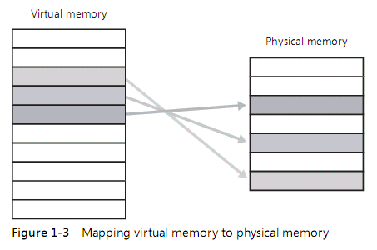
Virtual Memory

Slide 46
Virtual Memory (Cont.)
Because most systems have much less physical memory than the total virtual memory in use by the running processes, the memory manager transfers, or pages, some of the memory contents to disk.
Paging data to disk frees physical memory so that it can be used for other processes or for the operating system itself.

Slide 47
Virtual Memory (Cont.)
When a thread accesses a virtual address that has been paged to disk, the virtual memory manager loads the information back into memory from disk.
Applications don’t have to be altered in any way to take advantage of paging because hardware support enables the memory manager to page without the knowledge or assistance of processes or threads.

Slide 48
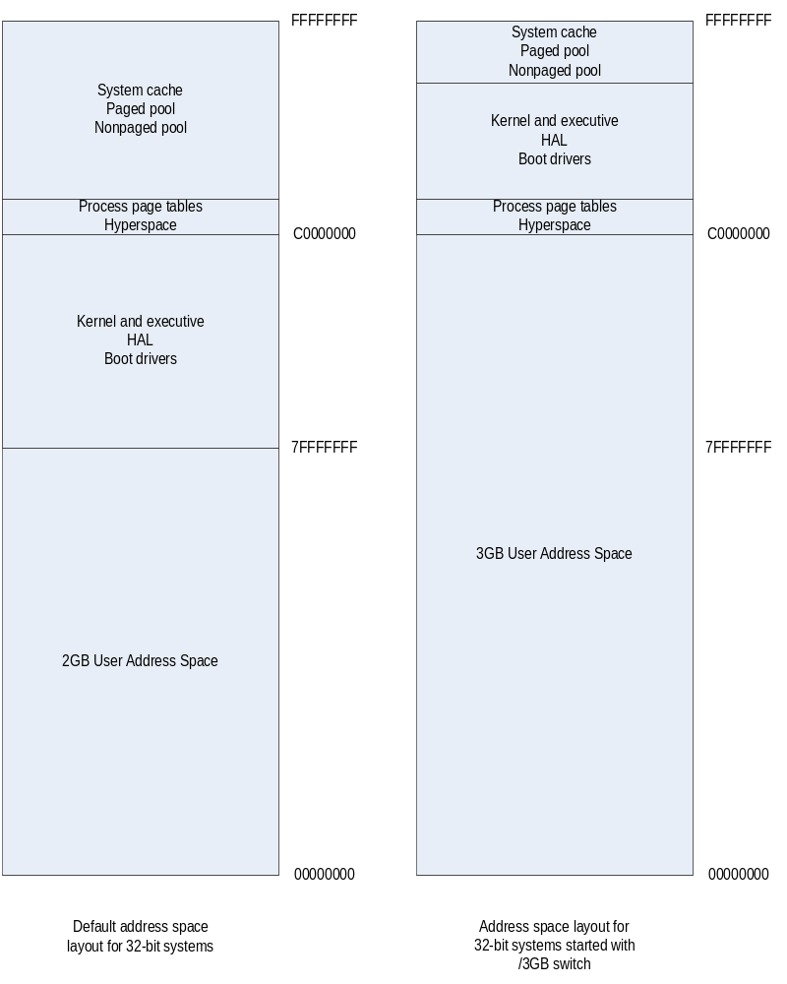
Virtual Memory (Cont.)
More

Slide 49
Virtual Memory (Cont.)
Windows provides a mechanism called Address Windowing Extension (AWE), which allows a 32-bit application to allocate up to 64 GB of physical memory and then map views, or windows, into its 2-GB virtual address space.
But puts the burden of managing mappings of virtual to physical memory on the programmer.

Slide 50
Virtual Memory (Cont.)
64-bit Windows on Itanium systems (64-bit)
  7152GB (7TB) for process
  6144GB for operating system
64-bit Windows on x64 system (64-bit)
  8192GB (8TB) for process
  6657GB for operating system
Note that these sizes do not represent the architectural limits for these platforms, but rather implementation limits in the current versions of 64-bit Windows.

Slide 51
Virtual Memory (Cont.)
On 32-bit x86 systems
  the virtual address space has a maximum of 4 GB.
  By default,
    from x00000000 through x7FFFFFFF to processes
    from x80000000 through xFFFFFFFF for operating system
  Windows 2000 Advanced Server, Windows 2000 Datacenter Server, Windows XP (SP2 and later), and Windows Server 2003 support boot-time options
    the /3GB and /USERVA qualifiers in Boot.ini
    up to 3 GB for processes, only 1GB for operating system

Slide 52
32-bit x86 Address Space
Default
3 GB user space
2 GB
User
process
space
3 GB
User
process
space
2 GB
System
Space
1 GB
System Space
Notes:
©2005 Microsoft Corporation. All rights reserved.
This presentation is for informational purposes only. Microsoft makes no warranties, express or implied, in this summary.

Slide 53
64-bit Address Spaces
64-bits = 17,179,869,184 GB
  x64 today supports 48 bits virtual = 262,144 GB
  IA-64 today support 50 bits virtual = 1,048,576 GB
x64
Itanium
8192 GB
(8 TB)
User
process
space
7152 GB
(7 TB)
User
process
space
6657 GB
System
Space
6144 GB
System
Space
Notes:
©2005 Microsoft Corporation. All rights reserved.
This presentation is for informational purposes only. Microsoft makes no warranties, express or implied, in this summary.

Slide 54
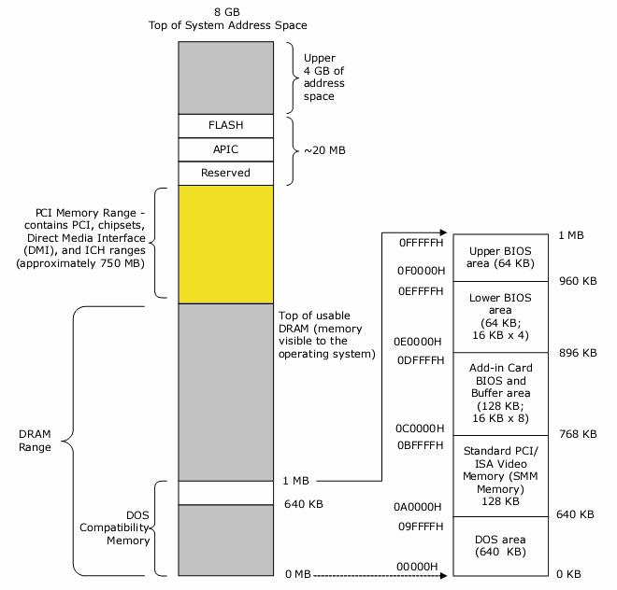
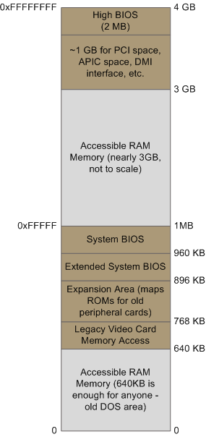
RAM Memory

Slide 55
Memory Protection Model
No user process can touch another user process address space (without first opening a handle to the process, which means passing through NT security)
  Separate process page tables prevent this
  “Current” page table changed on context switch from a thread in 1 process to a thread in another process
No user process can touch kernel memory
  Page protection in process page tables prevent this
  OS pages only accessible from “kernel mode”
    x86: Ring 0, Itanium: Privilege Level 0
  Threads change from user to kernel mode and back (via a secure interface) to execute kernel code
    Does not affect scheduling (not a context switch)
Notes:
©2005 Microsoft Corporation. All rights reserved.
This presentation is for informational purposes only. Microsoft makes no warranties, express or implied, in this summary.

Slide 56
Kernel Mode vs. User Mode
Windows uses two processor access modes (even if the processor on which Windows is running supports more than two): user mode and kernel mode.
  user application code runs in user mode
  operating system code runs in kernel mode
In kernel mode, a process is granted access to all system memory and all CPU instructions.

Slide 57
Kernel Mode vs. User Mode (Cont.)
By providing the operating system software with a higher privilege level than the application software has, the processor provides a necessary foundation for operating system designers to ensure that a misbehaving application can’t disrupt the stability of the system as a whole.
In the Intel x86 processor, Windows uses privilege level 0 (or ring 0) for kernel mode and privilege level 3 (or ring 3) for user mode.
The reason Windows uses only two levels is that some hardware architectures that were supported in the past (such as Compaq Alpha and Silicon Graphics MIPS) implemented only two privilege levels.

Slide 58
Kernel Mode vs. User Mode (Cont.)
Although each Windows process has its own private memory space, the kernel-mode operating system and device driver code share a single virtual address space.
Each page in virtual memory is tagged as to what access mode the processor must be in to read and/or write the page.
Read-only pages (such as those that contain executable code) are not writable from any mode.

Slide 59
Kernel Mode vs. User Mode (Cont.)
Windows doesn’t provide any protection to private read/write system memory being used by components running in kernel mode.
In other words, once in kernel mode, operating system and device driver code has complete access to system space memory and can bypass Windows security to access objects.
User applications switch from user mode to kernel mode when they make a system service call.

Slide 60
Terminal Services and Multiple Sessions
Terminal Services refers to the support in Windows for multiple interactive user sessions on a single system.
With Windows Terminal Services, a remote user can establish a session on another machine, log in, and run applications on the server.
The server transmits the graphical user interface to the client, and the client transmits the user’s input back to the server.

Slide 61
Terminal Services and Multiple Sessions (Cont.)
The first login session at the physical console of the machine is considered the console session, or session zero.
Additional sessions can be created through the use of the remote desktop connection program or on Windows systems through the use of fast user switching.

Slide 62
Terminal Services
Terminal Services refers to the support in Windows for multiple interactive user sessions on a single system.
With Windows Terminal Services, a remote user can
  establish a session on another machine
  log in
  and
  run applications on the server.

Slide 63
Terminal Service of Windows Server 2008
Windows Server 2008 supports two simultaneous remote connections.
  This is to facilitate remote management.
    For example, use of management tools that require being logged in to the machine being managed.
Windows Server 2008 Standard and Datacenter editions can support more than two sessions if appropriately licensed and configured as a terminal server.

Slide 64
Objects
In the Windows operating system, an object is a single, run-time instance of a statically defined object type.
An object type comprises a system-defined data type, functions that operate on instances of the data type, and a set of object attributes.
In Windows, a process is an instance of the process object type, a file is an instance of the file object type, and so on.

Slide 65
Objects (Cont.)
An object attribute is a field of data in an object that partially defines the object’s state.
  Example, the process ID and a base scheduling priority for process.
Object methods, the means for manipulating objects, usually read or change the object attributes.
  Example, the open method for a process would accept a process identifier as input and return a pointer to the object as output.

Slide 66
Objects (Cont.)
The most fundamental difference between an object and an ordinary data structure is that the internal structure of an object is hidden.
Only data that needs to be shared, protected, named, or made visible to user-mode programs is placed in objects.
Structures used by only one component of the operating system to implement internal functions are not objects.

Slide 67
Object Type
An object type comprises
  a system-defined data type
  functions that operate on instances of the data type
  and
  a set of object attributes.

Slide 68
Object Example (1)
If you write Windows applications, you might encounter
  process objects
  thread objects
  file objects
  and
  event objects
to name just a few examples.
These objects are based on lower-level objects that Windows creates and manages.

Slide 69
Object Example (2)
In Windows,
  a process is an instance of the process object type,
  a file is an instance of the file object type,
  and so on.

Slide 70
Object Attribute
An object attribute is a field of data in an object that partially defines the object’s state.
An object of type process, for example, would have attributes that include
  the process ID
  a base scheduling priority
  and
  a pointer to an access token object.

Slide 71
Object Method
Object methods, the means for manipulating objects, usually read or change the object attributes.
For example, the open method for a process would
  accept a process identifier as input
  and
  return a pointer to the object as output.

Slide 72
Difference between an Object and a Data Structure
The most fundamental difference between an object and an ordinary data structure is that the internal structure of an object is opaque.
You must call an object service to get data out of an object or to put data into it.
You can’t directly read or change data inside an object.
This difference separates the underlying implementation of the object from code that merely uses it, a technique that allows object implementations to be changed easily over time.

Slide 73
Tasks of Objects
Objects, through the help of a kernel component called the object manager, provide a convenient means for accomplishing the following four important operating system tasks:
  Providing human-readable names for system resources
  Sharing resources and data among processes
  Protecting resources from unauthorized access
  Reference tracking, which allows the system to know when an object is no longer in use so that it can be automatically deallocated

Slide 74
Objects and Structures
Not all data structures in the Windows operating system are objects.
Only data that needs to be shared, protected, named, or made visible to user-mode programs (via system services) is placed in objects.
Structures used by only one component of the operating system to implement internal functions are not objects.

Slide 75
Core Security Capabilities
The core security capabilities of Windows include
  discretionary (need-to-know) and mandatory integrity protection for all shareable system objects
    such as files, directories, processes, threads, and so forth
  security auditing
    for accountability of subjects, or users and the actions they initiate
  user authentication at logon
  and
  the prevention of one user from accessing uninitialized resources (such as free memory or disk space) that another user has deallocated.

Slide 76
Access Control over Objects
Windows has three forms of access control over objects:
  Discretionary access control
  Privileged access control
  Mandatory integrity control

Slide 77
Discretionary Access Control
Discretionary access control is the method by which owners of objects (such as files or printers) grant or deny access to others.
When users log in, they are given a set of security credentials, or a security context.
When they attempt to access objects, their security context is compared to the access control list on the object they are trying to access to determine whether they have permission to perform the requested operation.

Slide 78
Privileged Access Control
Privileged access control is necessary for those times when discretionary access control isn’t enough.
It’s a method of ensuring that someone can get to protected objects if the owner isn’t available.
  For example, if an employee leaves a company, the administrator needs a way to gain access to files that might have been accessible only to that employee.
  In that case, under Windows, the administrator can take ownership of the file so that you can manage its rights as necessary.

Slide 79
Mandatory Integrity Control
In the context of the Microsoft Windows range of operating systems, Mandatory Integrity Control (MIC) or Integrity levels is a core security feature, introduced in Windows Vista and Windows Server 2008,
  Adds Integrity Levels (IL) to processes running in a login session.
This mechanism is able to selectively restrict the access permissions of certain programs or software components in contents that are considered to be potentially less trustworthy, compared with other contexts running under the same user account that are more trusted.

Slide 80
Security (Cont.)
Security in the interface of the Windows API:
  The Windows subsystem protects shared Windows objects from unauthorized access by placing Windows security descriptors on them.
  The first time an application tries to access a shared object, the Windows subsystem verifies the application’s right to do so. If the security check succeeds, the Windows subsystem allows the application to proceed.

Slide 81
Registry (1)
The registry is the system database that contains the information required to boot and configure
  the system
  systemwide software settings that control the operation of Windows
  the security database
  and
  per-user configuration settings
    such as which screen saver to use

Slide 82
Registry (2)
The registry is a window into in-memory volatile data, such as
  the current hardware state of the system
    what device drivers are loaded, the resources they are using, and so on
  as well as
  the Windows performance counters.
The performance counters, which aren’t actually “in” the registry, are accessed through the registry functions.

Slide 83
Unicode
Windows differs from most other operating systems in that most internal text strings are stored and processed as 16-bit-wide Unicode characters.
Unicode is an international character set standard that defines unique 16-bit values for most of the world’s known character sets.
  (For more information about Unicode, see www.unicode.org as well as the programming documentation in the MSDN Library.)

Slide 84
Windows Functions with String Parameters
Because many applications deal with 8-bit (single-byte) ANSI character strings, Windows functions that accept string parameters have two entry points:
  a Unicode (wide, 16-bit) version
  and
  an ANSI (narrow, 8-bit) version.

Slide 85
Narrow Versions
The Windows 95, Windows 98, and Windows Millennium Edition implementations of Windows don’t implement all the Unicode interfaces to all the Windows functions, so applications designed to run on one of these operating systems as well as Windows Vista, 7, 8 and 10 and Windows Server 2008 typically use the narrow versions.
If you call the narrow version of a Windows function, input string parameters are converted to Unicode before being processed by the system and output parameters are converted from Unicode to ANSI before being returned to the application.

Slide 86
Convert the ANSI Characters into Unicode
Thus, if you have an older service or piece of code that you need to run on Windows but this code is written using ANSI character text strings, Windows will convert the ANSI characters into Unicode for its own use.
However, Windows never converts the data inside files—it’s up to the application to decide whether to store data as Unicode or as ANSI.

Slide 87
User Mode Subsystems (1/4)
User Mode
Service processes
User applications
Environment
subsystem
server
processes
System
support
processes
Core Windows subsystem DLLs
Kernel32.dll, Advapi32.dll, User32.dll, Gdi32.dll
NTDLL.DLL (used by all except User32.dll and Gdi32.dll)
Win32 subsystem
  Provides the Win32 API (documented functions)
  Implemented as a set of DLLs
  User applications link with these libraries and share them
  Ntoskrnl.exe and Win32k.sys (system service calls)
NTDLL.DLL
  Internal support functions and system service dispatch stubs to executive functions
Notes:
Windows NT Architecture User Mode Subsystems.
The Win 32 subsystem, is the most important element for a Windows Programmer, it provides the Win 32 API. This subsystem has been implemented as a set of DLLs that export the API. User applications link with these libraries which translate documented functions into the appropriate internal and mostly undocumented kernel mode system service calls to N T O S K R N L.exe and Win 32 k.sys. The multiple running user applications that link with a DLL get the benefits of using a DLL.
The NTDLL.DLL, contains the Internal support functions, and the system service dispatch stubs to executive functions.

Slide 88
User Mode Subsystems (2/4)
Service processes
User applications
Environment
subsystem
server
processes
System
support
processes
Core Windows subsystem DLLs
Kernel32.dll, Advapi32.dll, User32.dll, Gdi32.dll
NTDLL.DLL (used by all except User32.dll and Gdi32.dll)
KERNEL32.DLL
  Base functionality API
  Exports over 900 functions
  Ex. function to open a file (CreateFile), read (ReadFile), write
  (WriteFile), create a new process and its primary thread (CreateProcess) etc.
ADVAPI32.DLL
  Advanced Windows API
  Exports functions like EncryptFile, client-side Service Control Manager (SCM) API etc.
Notes:
Windows NT Architecture User Mode Subsystems.
The KERNEL 32.DLL, contains the Base functionality API and exports over 900 functions. The examples are functions to open a file using Create File, read using Read File, write using Write File, create a new process and its primary thread using Create Process etc.
The A D V A P I 32.DLL, contains the Advanced Windows API which exports functions like Encrypt File, client side Service Control Manager the S C M API etc.

Slide 89
User Mode Subsystems (3/4)
Service processes
User applications
Environment
subsystem
server
processes
System
support
processes
Core Windows subsystem DLLs
Kernel32.dll, Advapi32.dll, User32.dll, Gdi32.dll
NTDLL.DLL (used by all except User32.dll and Gdi32.dll)
USER32.DLL
  Windowing and Window Messaging API
  Exports over 700 functions
  Ex. functions to create a window (CreateWindowEx), dialog (CreateDialogParam), (SendMessage), (GetMessage) etc.
GDI32.DLL
  Graphical drawing API
  Exports over 600 functions
  Ex. functions to create a bitamp (CreateBitmap), set color of text (SetTextColor) etc.
Notes:
Windows NT Architecture User Mode Subsystems.
The USER 32.DLL, contains the Windowing and window messaging API and exports over 700 functions. The examples are functions to create a window using Create Window Ex, create a dialog using Create Dialog Param, send message to windows using Send Message, retrieve message from the calling thread’s message queue using Get Message etc.
The G D I 32.DLL, contains the Graphical drawing API and exports over 600 functions. The examples are functions to create a bitamp using Create Bitmap, set color of text using Set Text Color etc.

Slide 90
User Mode Subsystems (4/4)
Service processes
User applications
Environment
subsystem
server
processes
System
support
processes
Core Windows subsystem DLLs
Kernel32.dll, Advapi32.dll, User32.dll, Gdi32.dll
NTDLL.DLL (used by all except User32.dll and Gdi32.dll)
The system service dispatch instructions are implemented in User32.DLL and GDI32.DLL directly without needing the NTDLL.DLL
PnP Subsystem
  User Mode part of PnP subsystem
  API for applications to accomplish device management
  Applications can be notified about device arrival and removal
Power Subsystem
  API for applications in provide power-saving features
  Ex. Spinning down disks, and CD-ROM, and DVD drives etc.
Notes:
Windows NT Architecture User Mode Subsystems.
The system service dispatch instructions are implemented in User 32.DLL and G D I 32.DLL directly without needing the N T DLL.DLL,
The P N P Subsystem, is the User Mode part of P N P subsystem which provides applications with a way to accomplish device management, including a registration mechanism by which they can be notified about device arrival and removal.
The Power Subsystem, provides API for the benefit of higher level applications in providing power saving features such as spinning down disks, CD-ROM and DVD drives, video monitors etc.

Slide 91
Kernel Mode Subsystems (1/3)
Kernel Mode
System Service Dispatcher
EXECUTIVE API (Kernel-Mode Callable Interfaces)
WINDOWS
USER,
GDI
I/O Manager
File
System
Cache
Object
Manager
PnP
Manager
Security
Reference
Monitor
Virtual Memory
Manager
Processes
&
Threads
Configuration
Manager
Local
Procedure
Call
File
System
Graphics
Drivers
KERNEL
Device Drivers
NTOSKRNL.EXE
WIN32K.SYS
HARDWARE ABSTRACTION LAYER (HAL)
HAL.DLL
Kernel mode hosts all privileged processes running at level 0 (ring 0) of the Intel x86 architecture
It consists of three primary subsystems:
        Windows NT Executive and System Services
        Windows NT Kernel
        Hardware abstraction layer (HAL)
Notes:
Windows NT Architecture Kernel Mode Subsystems.
Kernel mode hosts all privileged processes running at level 0 that is ring 0 of the Intel X 86 architecture.
It consists of three primary subsystems,
The Windows NT Executive and System Services.
The Windows NT Kernel.
The Hardware abstraction layer H A L.

Slide 92
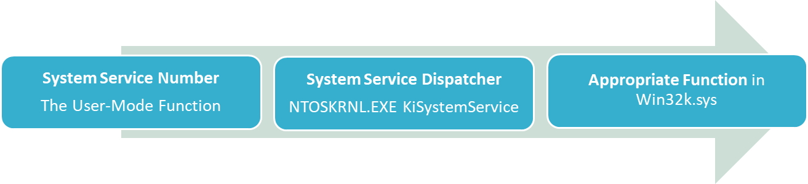
Kernel Mode Subsystems (2/3)
Kernel Mode
System Service Dispatcher
EXECUTIVE API (Kernel-Mode Callable Interfaces)
WINDOWS
USER,
GDI
I/O Manager
File
System
Cache
Object
Manager
PnP
Manager
Security
Reference
Monitor
Virtual Memory
Manager
Processes
&
Threads
Configuration
Manager
Local
Procedure
Call
File
System
Graphics
Drivers
KERNEL
Device Drivers
NTOSKRNL.EXE
WIN32K.SYS
HARDWARE ABSTRACTION LAYER (HAL)
HAL.DLL
WIN32K.SYS
  Kernel-Mode part of the Windows subsystem
  A device driver which contains the Window Manager and the Graphics Device Interface components
Notes:
Windows NT Architecture Kernel Mode Subsystems.
The WIN 32 K.SYS, is the Kernel Mode part of the Windows subsystem. This is a device driver which contains the Window Manager and the Graphics Device Interface components. For the functions of USER 32.DLL and G D I 32.DLL which are part of the core User Mode Windows subsystem, the system service dispatch instructions are implemented in those DLLs directly without needing the N T DLL.DLL which has these implemented for all the other core User Mode Windows subsystem DLLs. The system service number representing the function is passed to system service dispatcher the N T O S K R N L.EXE function K I System Service, which calls the appropriate function in the WIN 32 K.SYS

Slide 93
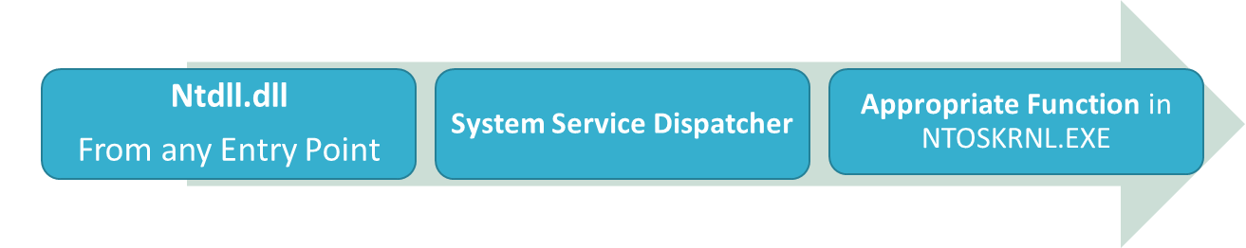
Kernel Mode Subsystems (3/3)
Kernel Mode
System Service Dispatcher
EXECUTIVE API (Kernel-Mode Callable Interfaces)
WINDOWS
USER,
GDI
I/O Manager
File
System
Cache
Object
Manager
PnP
Manager
Security
Reference
Monitor
Virtual Memory
Manager
Processes
&
Threads
Configuration
Manager
Local
Procedure
Call
File
System
Graphics
Drivers
KERNEL
Device Drivers
NTOSKRNL.EXE
WIN32K.SYS
HARDWARE ABSTRACTION LAYER (HAL)
HAL.DLL
NTOSKRNL.EXE
  Executive and Kernel
  Ntdll.dll entry points contain an architecture-specific instruction that causes a transition into kernel mode
Notes:
Windows NT Architecture Kernel Mode Subsystems.
The N T O S K RN L.EXE, consists of the Executive and the Kernel. N T DLL.DLL contains entry points with the same names as the functions in the Windows subsystem DLLs. The code inside the entry points contain an architecture specific instruction that causes a transition into the kernel mode, to invoke the system service dispatcher which after verifying some parameters, calls the actual kernel mode system service, that contains the real code inside the N T O S K R N L.EXE

